Slide 1
Improving Stewardship
Opportunities & Tensions
Spring Membership Meeting March 2021

Slide 2
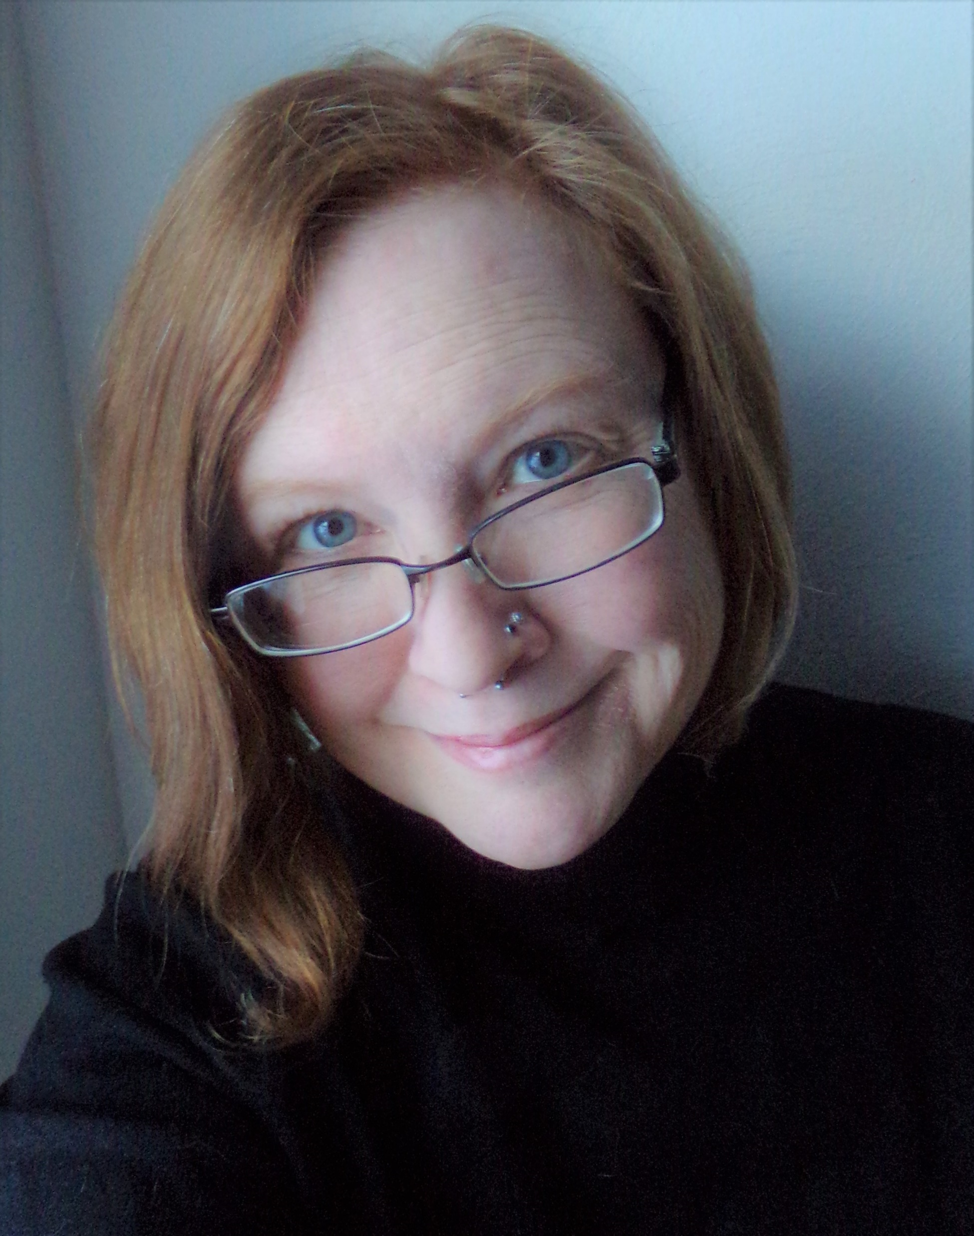
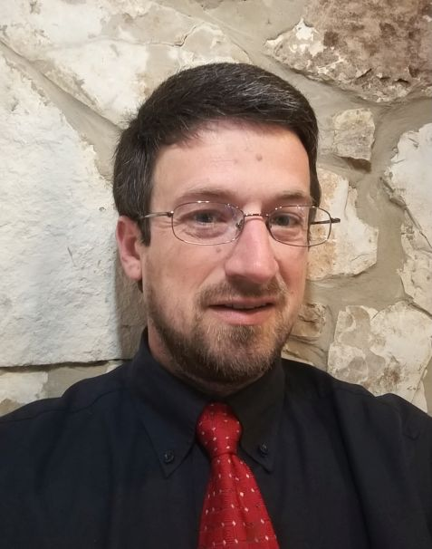
Kari May
Digital Archivist & Preservation Librarian
Clinton Graham
Systems Development Lead, ULS IT

Slide 3
Implementing full digital preservation in the University of Pittsburgh Library System (ULS)
Selecting Preservica
Setting standards & drafting a digital preservation policy
Integrating systems using APIs
Opening new paths with authenticated access

Slide 4
Implementing full digital preservation in the ULS

Slide 5
Selecting Preservica

Slide 6
APIs
Authenticated Access

Slide 7
Setting standards & drafting a policy

Slide 8
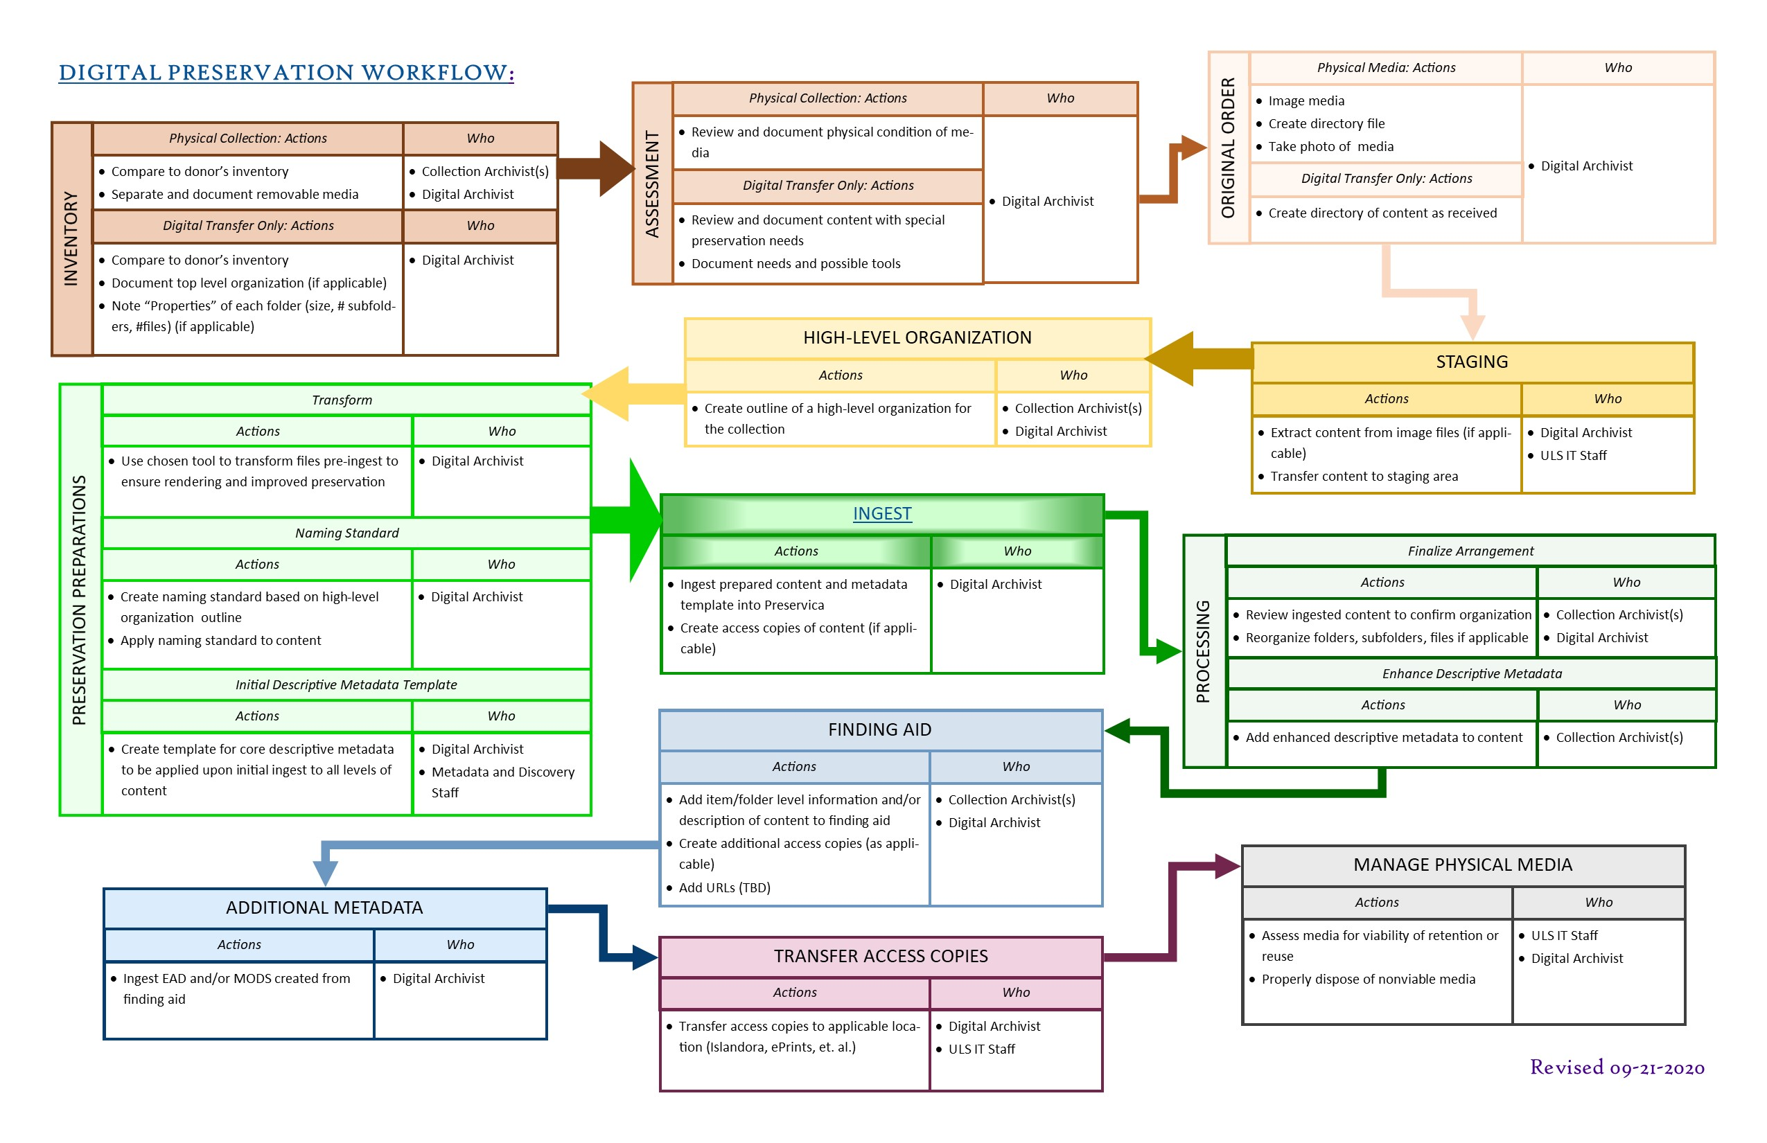

Slide 9
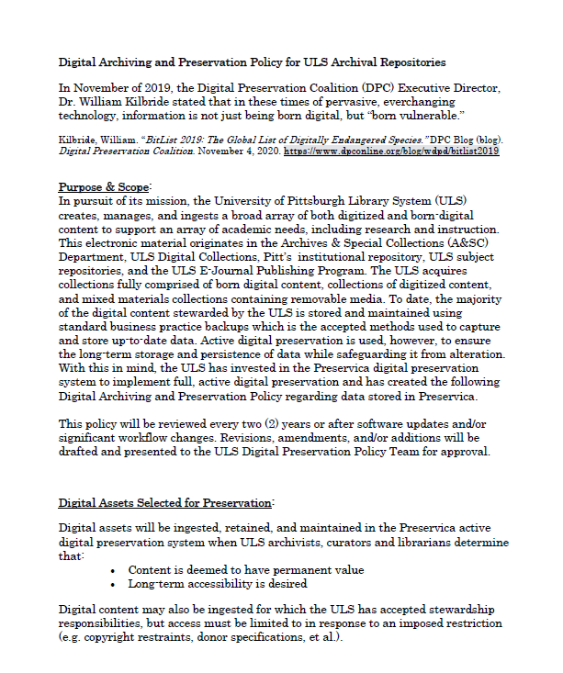
Purpose & Scope
Digital Assets Selected for Preservation
Roles & Responsibilities
Preserving Authenticity
Metadata
Storage
Archival Processing of Digital Assets
Intellectual Property
Financial Statement

Slide 10
Integrating systems using APIs

Slide 11
One Philosophy
Open Source in support of Open Access

Slide 12
Two Challenges
Preservation First
Preservation For

Slide 13
Three Platforms
Islandora
Public Knowledge Project
Eprints (or replacement)

Slide 14
Find our work
https://github.com/ulsdevteam/

Slide 15
Opening pathways with authenticated access

Slide 16
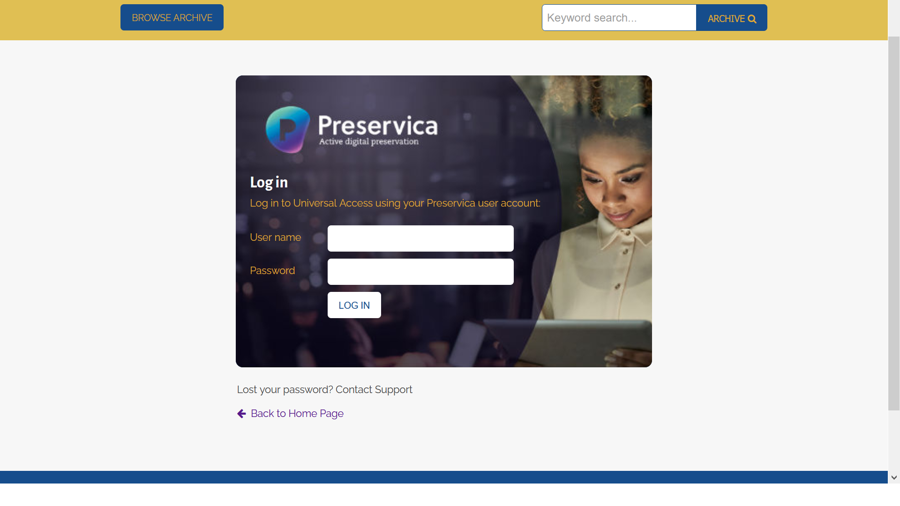

Slide 17
Summary
Full digital preservation practices is a solid step in improving stewardship of ULS digital assets
Utilizing APIs to integrate the various repositories will be another solid step to improved stewardship
Authenticated access to specific collections will provide improved potential for research using collections with limited access and the creation of scholarly outputs.

Slide 18
Thank you
Kari May
Digital Archivist & Preservation Librarian
karimay@pitt.edu
Clinton Graham
Systems Development Lead, ULS IT
ctgraham@pitt.edu
Spring Membership Meeting March 2021

